Slide 1
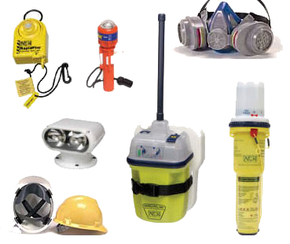
Technical Descriptions

Slide 2
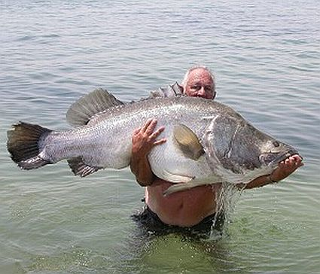
Size
This is a big/huge/enormous fish

Slide 3

Size
A small/tiny/miniature dog

Slide 4


Shape Adjectives
Triangular
Rectangular
Round
Oval
Cylindrical
Square

Slide 5
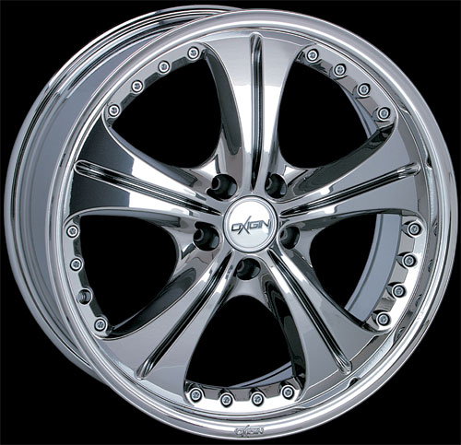
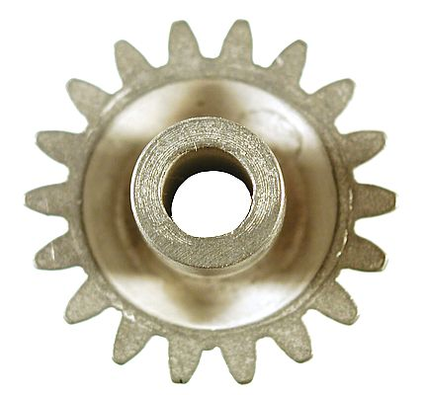
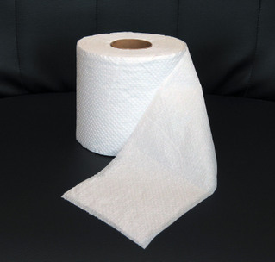
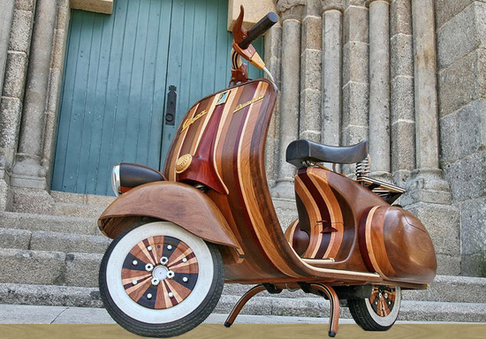
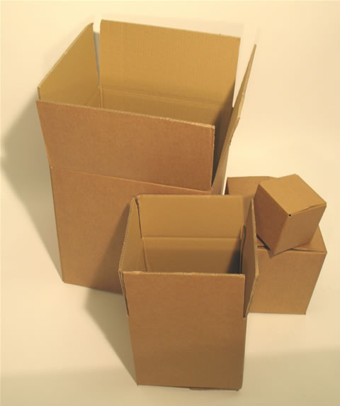
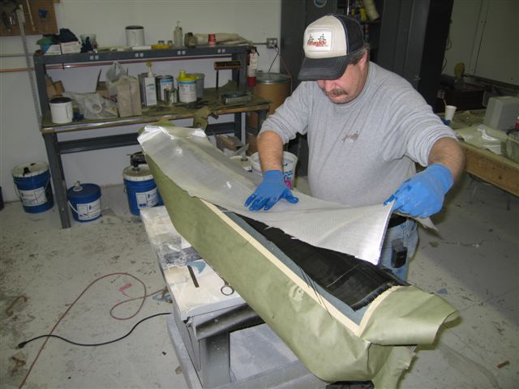
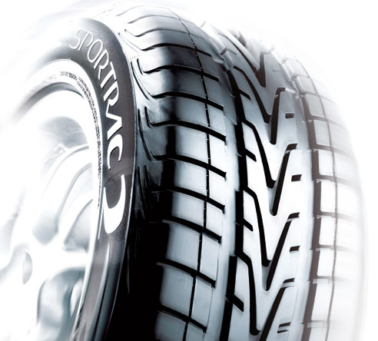
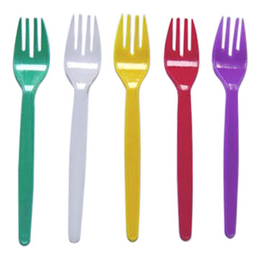
Materials

Slide 6
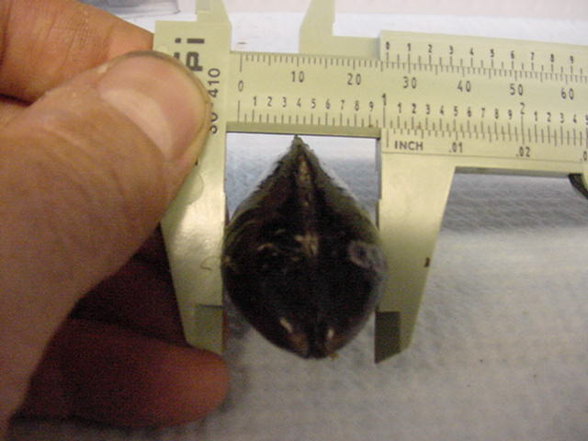
Width/Height
How wide is the mussel?
It has a width of 26 mm.
How high is it?
It has a height of 32 mm
The mussel is 26mm wide and 32mm high

Slide 7
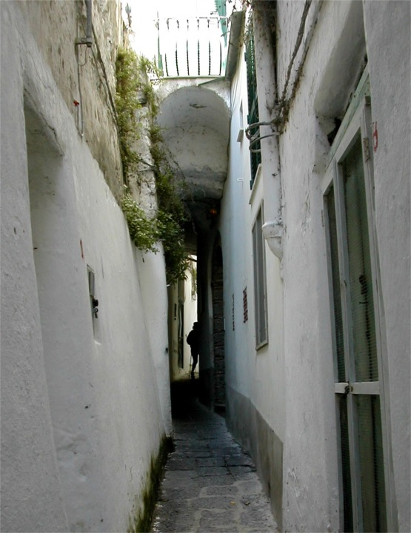
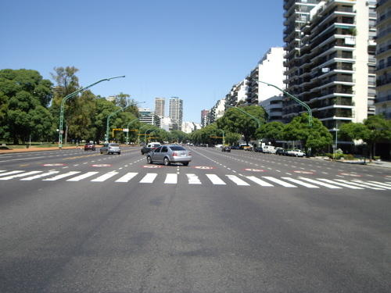
Width
Many streets in Brussels are very narrow, but the streets in Chicago are very wide.

Slide 8
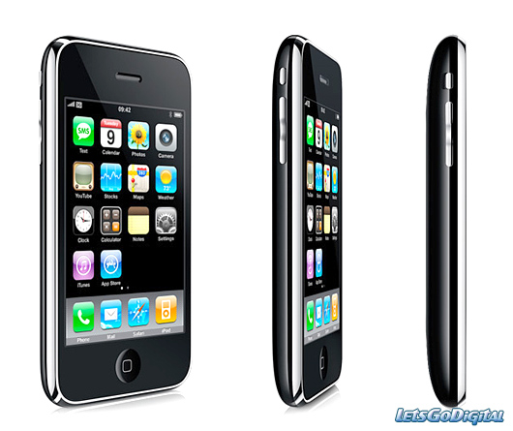
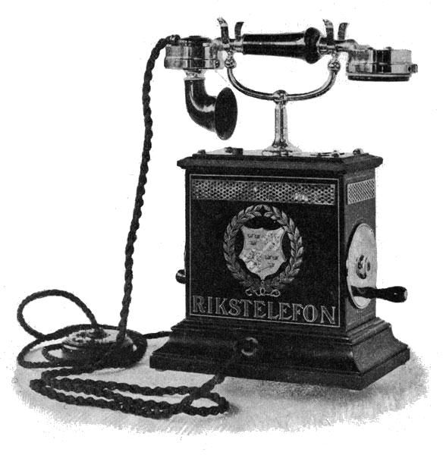
Weight
Most modern telephones are lightweight. My iphone is much lighter than my mother’s mobile phone.
This old phone looks heavy. I wonder what it weighs? It must weigh a few kilos! It is certainly heavier than modern phones.

Slide 9
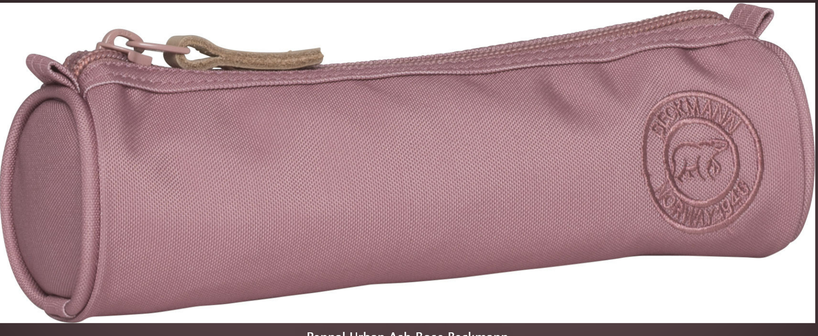
Task
Think of an object (or find a picture online) and using the formula below:
a) write a description or b) describe it to a classmate and let them guess what it is.
Size | colour | shape | material | Used for | Extra info
It’s a small pink oblong thing made from a textile used for keeping my pens together. It also has a zip at the top.

